Slide 1

Leveraging Microsoft for Sustainable Campus Practices
Team CtrlShiftTech: Ayush Singh
Kamna Kumari
Shaik Mohammed Sohail
Shubham

Slide 2
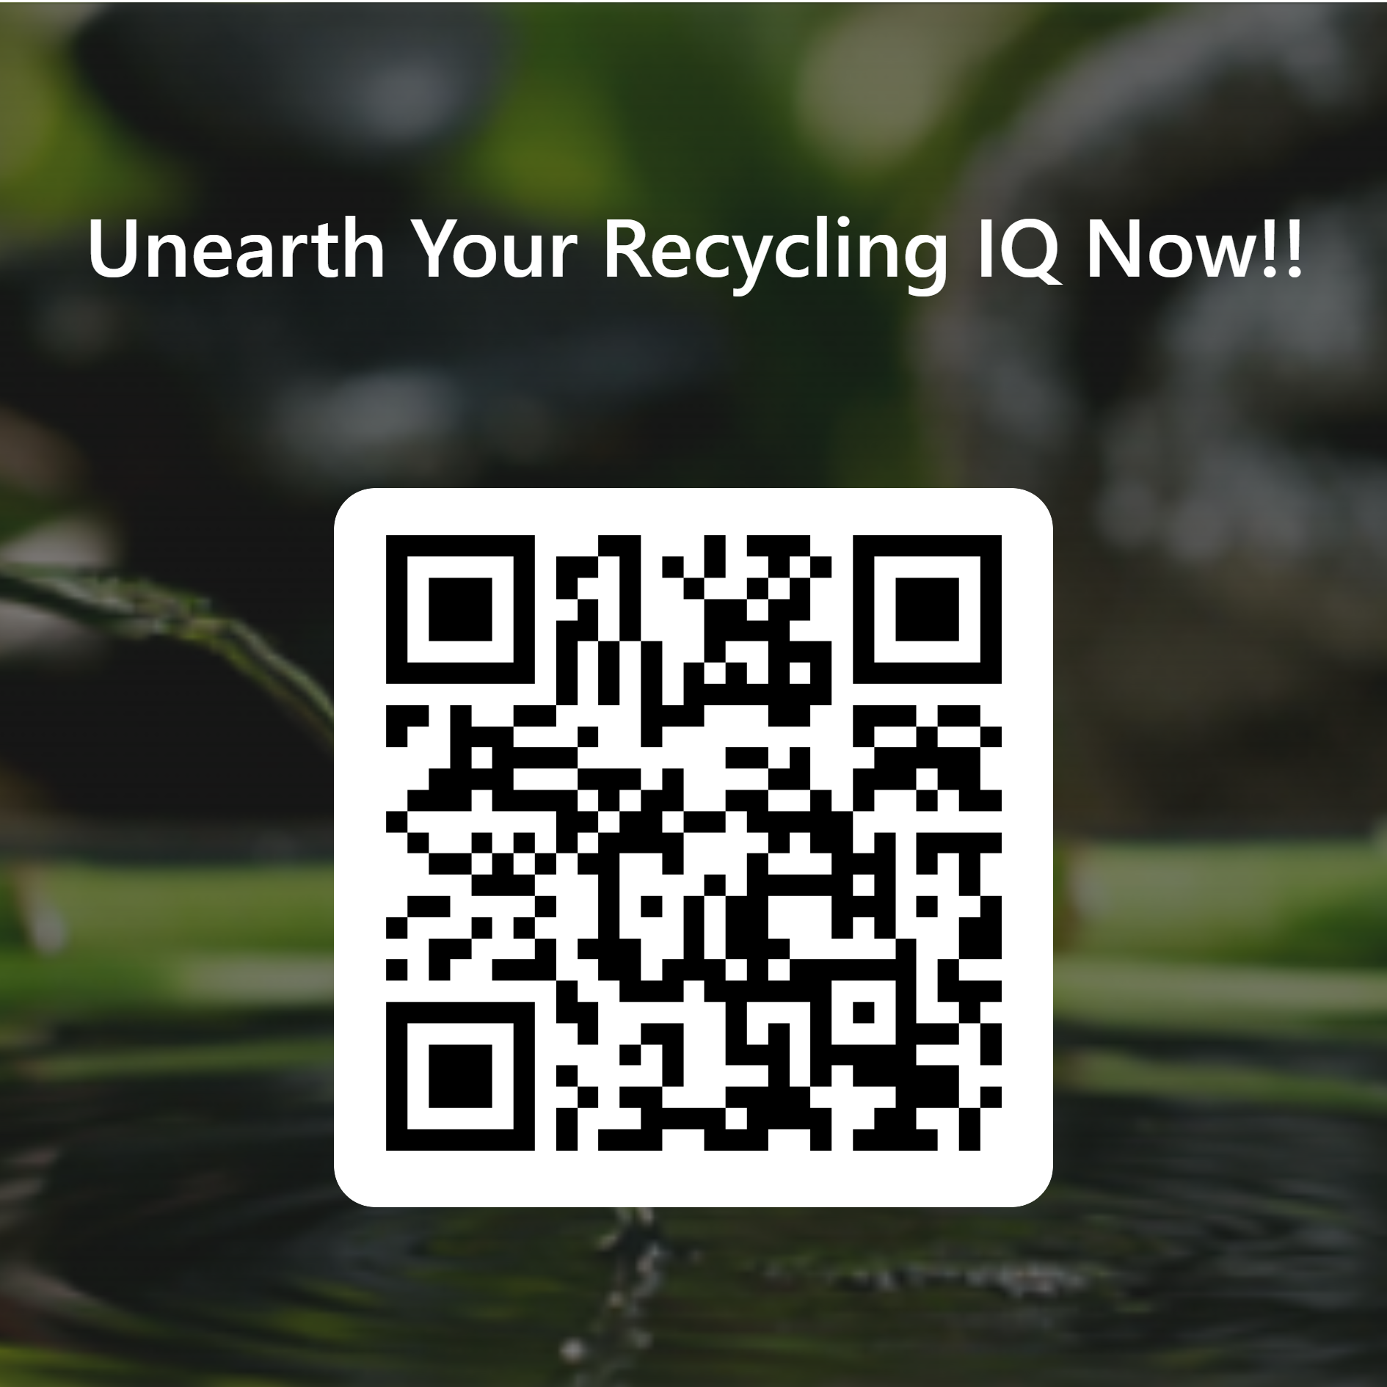
Please scan the code for the Quiz

Slide 3



Objective
Problem 1: Inefficient waste management on campus contributes to environmental degradation. Problem 2: Lack of awareness regarding the appropriate disposal methods for various sources, leading to increased environmental impact.
Solutions: 1) Sustainable Practices Survey
2) Data-Driven Waste Management
3) Data Analysis & Visualization

Slide 4
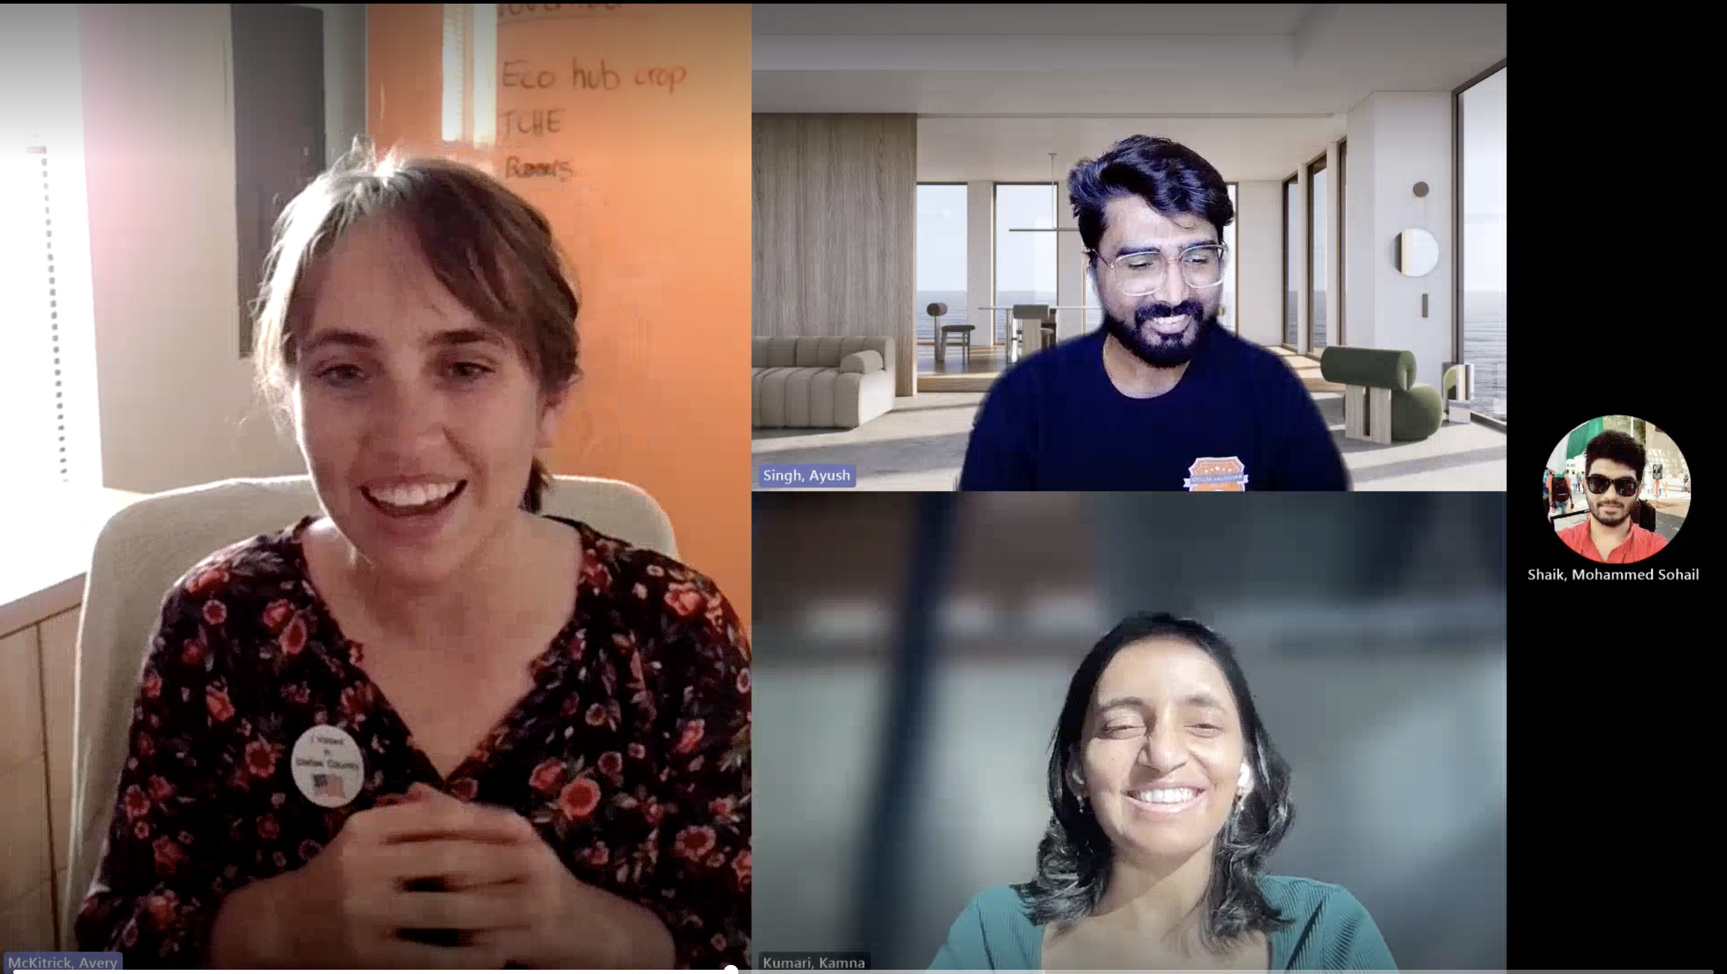

We interviewed Avery from Office of Sustainability – UT Dallas and got information regarding the waste disposal and recycling practices in and around campus.
They work diligently towards segregating the different types of waste and categorizing it appropriately.

Slide 5
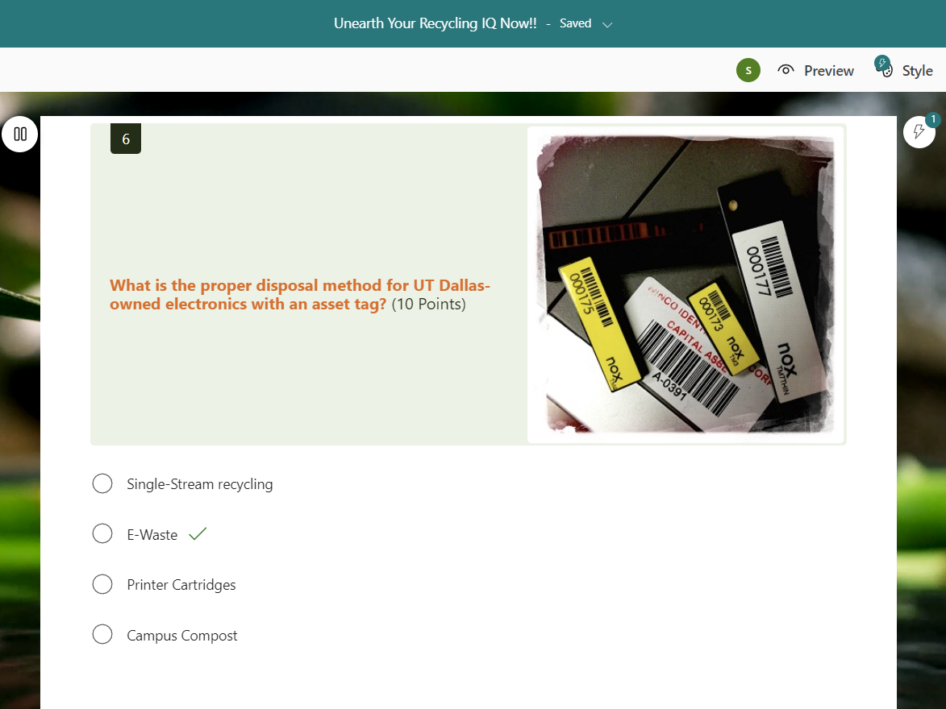
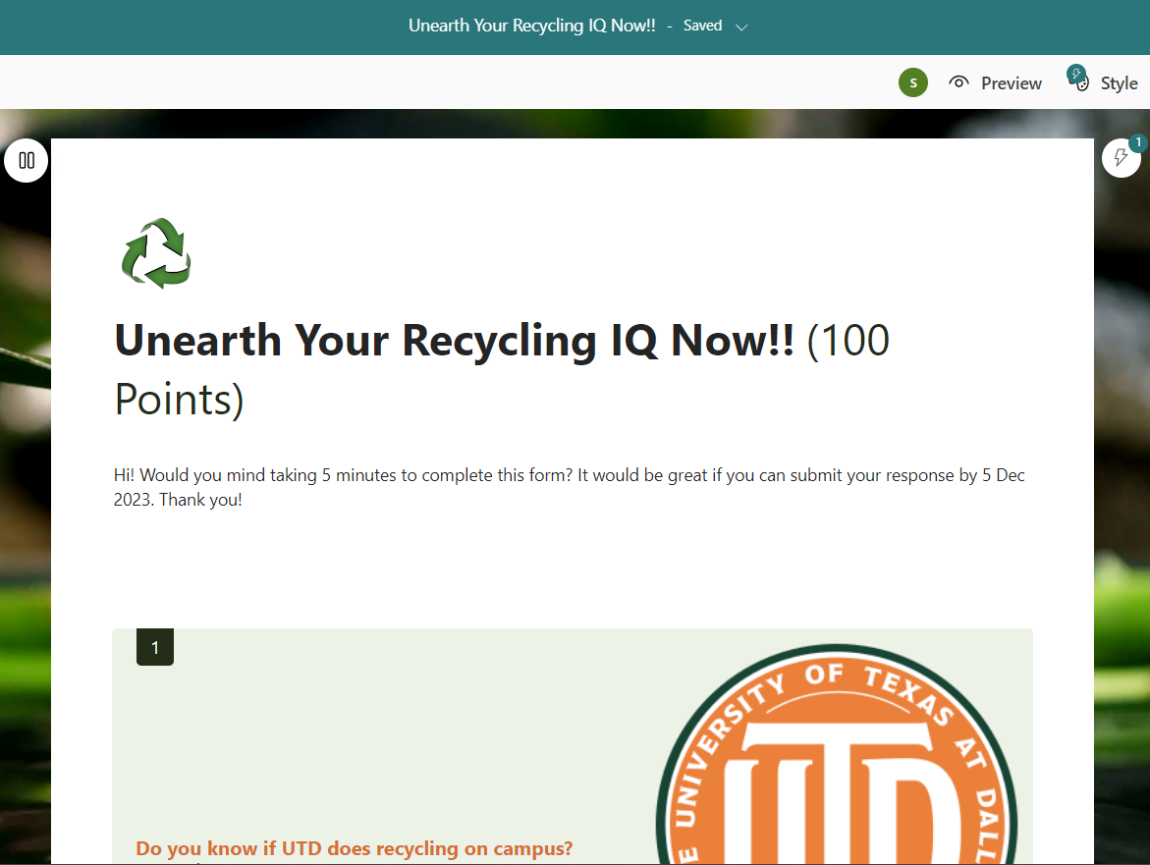
Application 1: Microsoft Forms
Quiz format to make learning experience fun!
Has 10 questions on appropriate recycling practices and types of waste.
Post quiz completion, lists out the correct/incorrect answers.
Data can be utilized for identifying key areas where more awareness is needed.

Slide 6
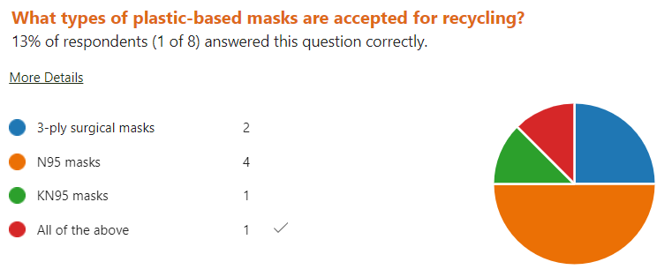
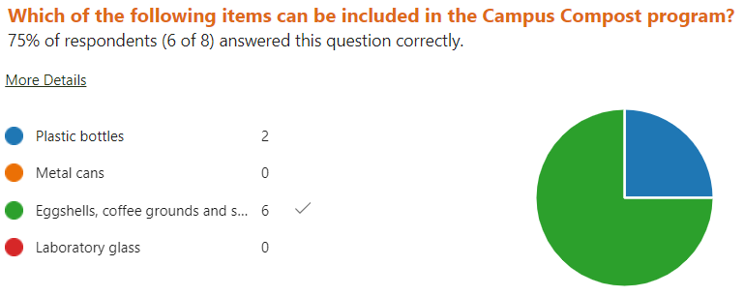
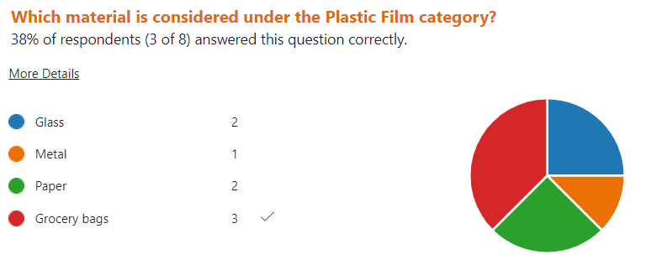
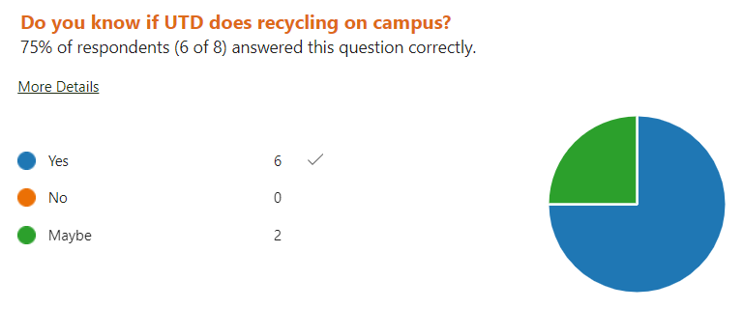
Survey Responses

Slide 7

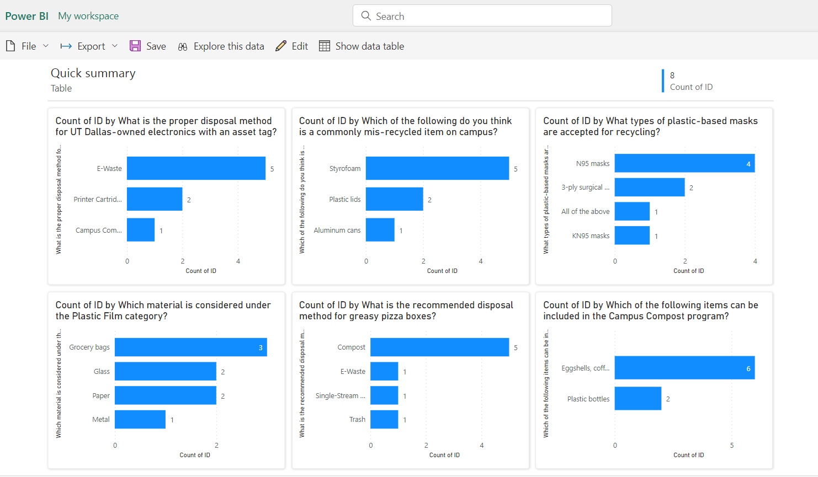
Application 2: Power BI

Slide 8
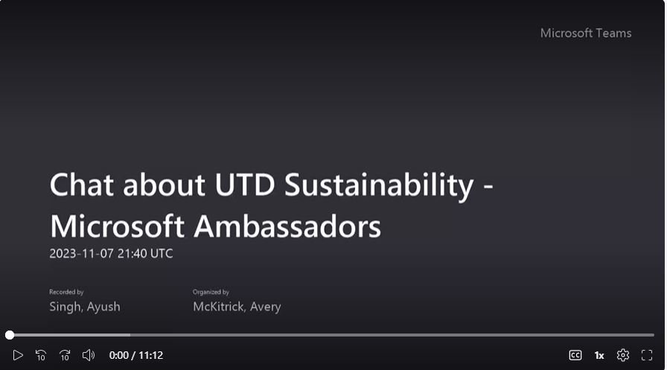
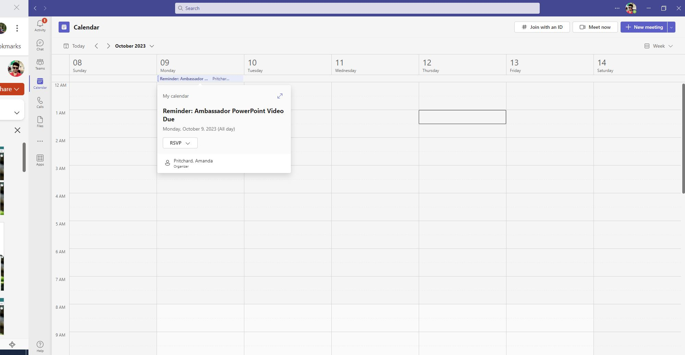
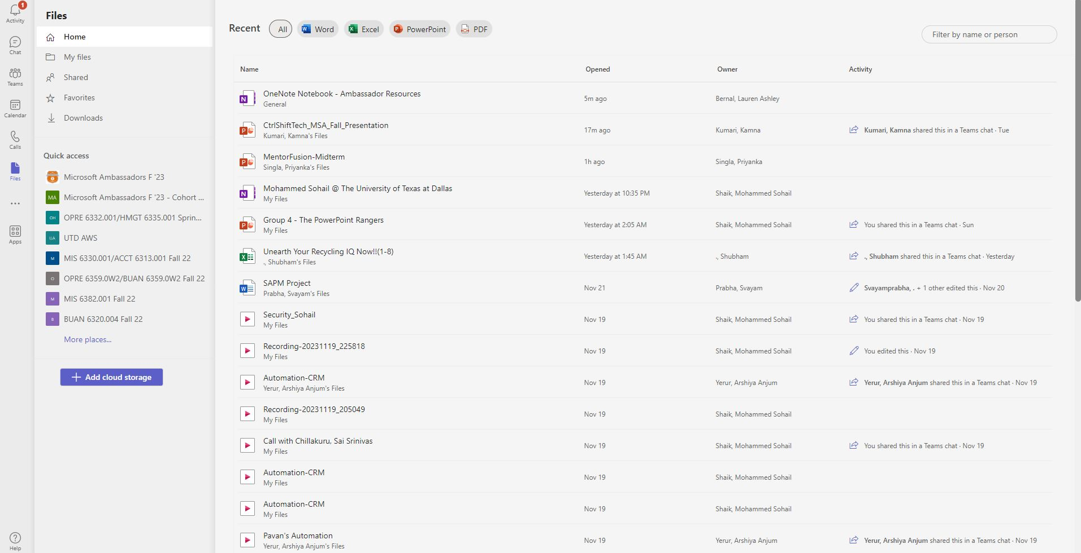
Application 3: Microsoft Teams
Meetings and Video Conferencing.
Calendar Tab and Meeting Reminders.
Files Tab with Collaboration and Integration with OneDrive & SharePoint

Slide 9
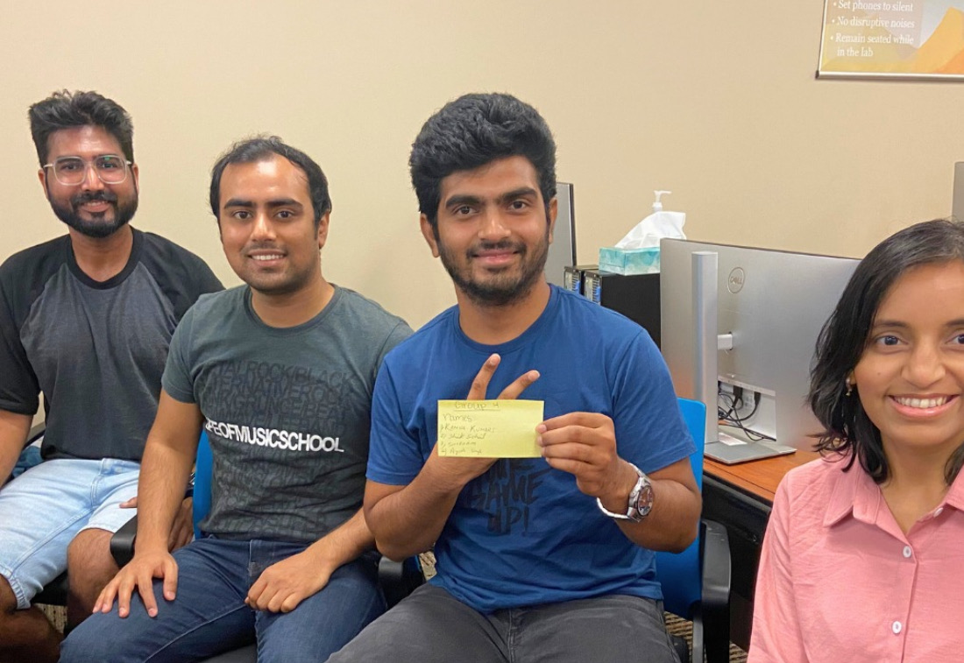
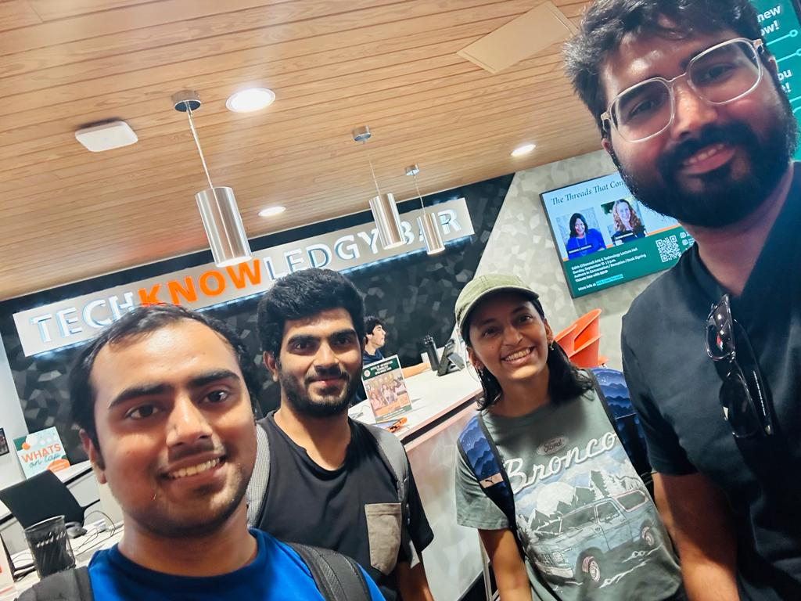
Team CtrlShiftTech Presents

Slide 10
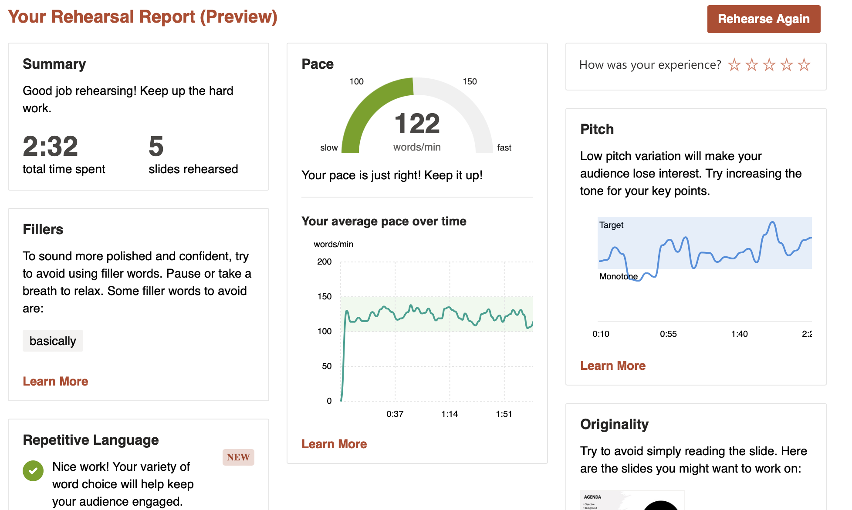
Kamna Presenter Coach

Slide 11
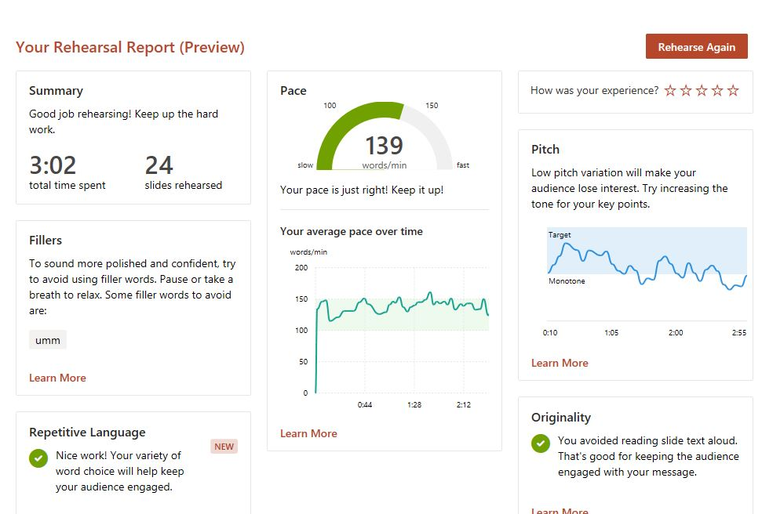
Sohail Presenter Coach

Slide 12
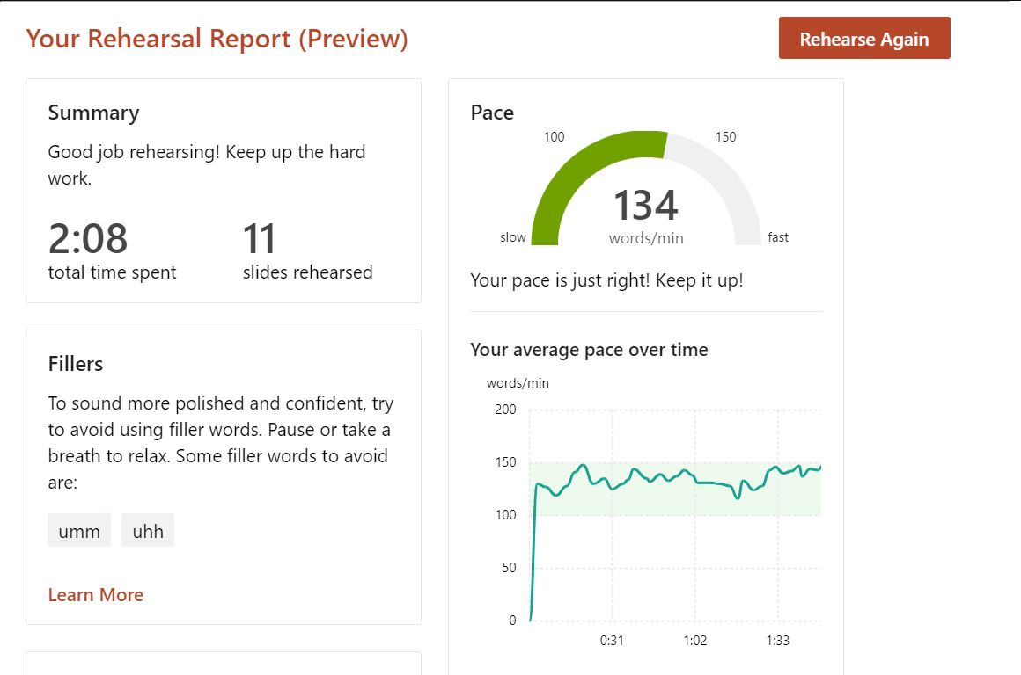
Ayush Presenter Coach

Slide 13
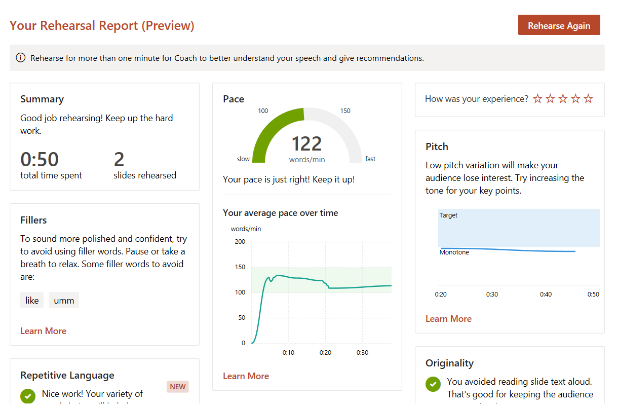
Shubham Presenter Coach

Slide 14

This Photo by Unknown author is licensed under CC BY.

